Slide 1

Virtual Reality
Student Name:- Rishabh R Patel
Enrolment Number:-12002040701135

Slide 2
Contents
What is VR
History of VR
Types of VR
Applications of VR
Advantages and Disadvantages
Resources

Slide 3

What is VR?
Virtual Reality means feeling the imaginary world , rather than the real one. The imaginary world is a simulation running in a computer.
Virtual Reality is the term used for computer generated 3D environments that allow the user to enter and interact with alternate realities.
The definition of ‘ Virtual ’ is near and ‘ Reality ’ is what we experience as human beings.

Slide 4
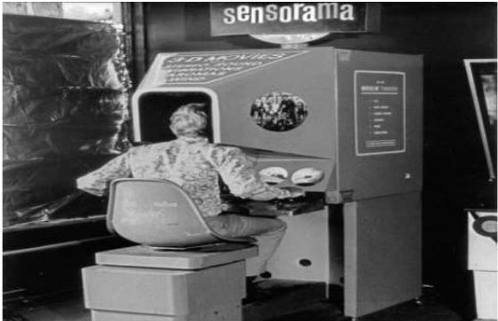
History of VR
More than one person has been involved in the development of this technological system.
In 1950's visionary cinematography Morton Heilig built a single user console called Sensorium. This enabled the user watch television in 3 dimensional ways.

Slide 5
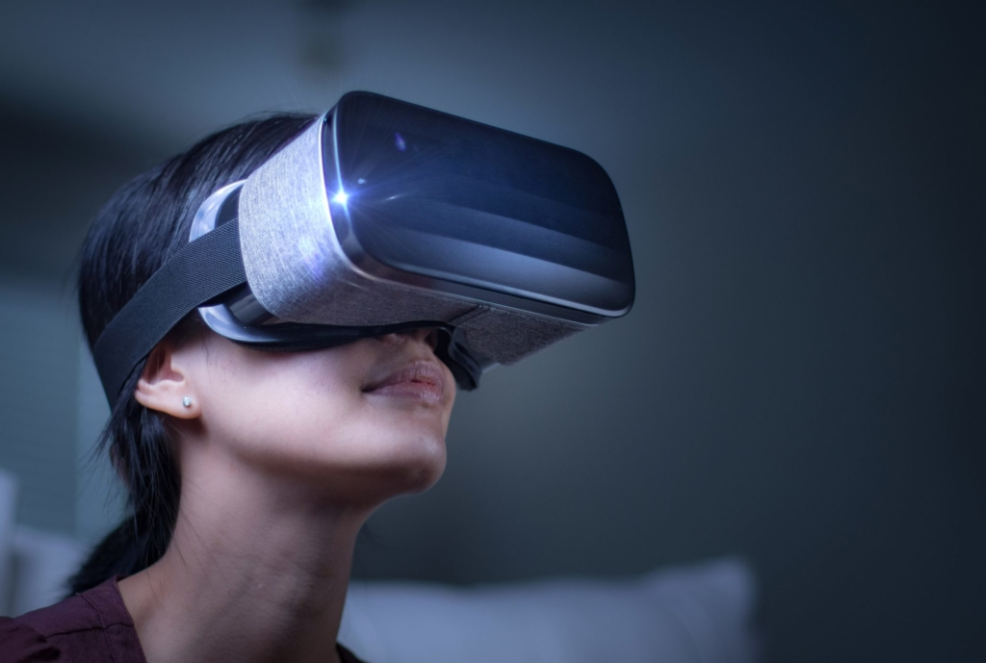
Types of VR
Immersive Virtual Reality
Non-Immersive Virtual Reality
Window on world Virtual Reality

Slide 6
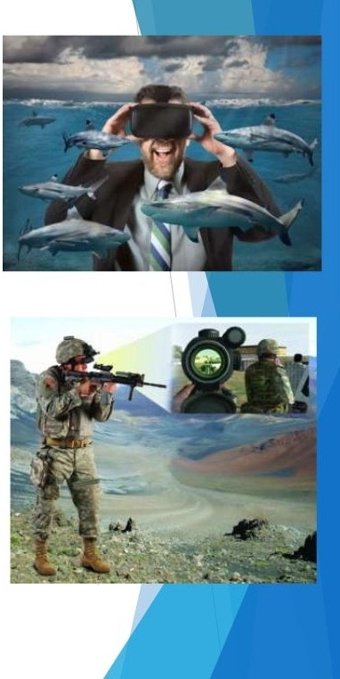
Immersive Virtual Reality
Immersion into virtual reality is a perception of being physically present in a non-physical world.
Elements of virtual environm ents that increase the immersive ness of the experience:
Continuity of surroundings
Conformance to human vision
Freedom of movement
Physical interaction
Physical feedback

Slide 7
Non-Immersive Virtual Reality
Non-immersive virtual reality refers to a virtual experience through a computer where you can control some characters or activities within the software, but the environment is not directly interacting with you.

Slide 8
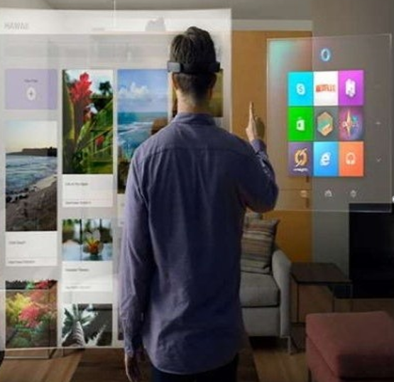
Window on world Virtual Reality
Desktop base Virtual Reality involves displaying a 3-dimensional virtual on regular desktop display without use of any specialized movement tracking environment.

Slide 9
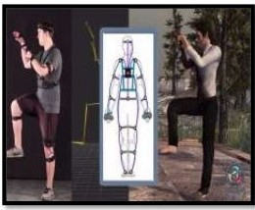
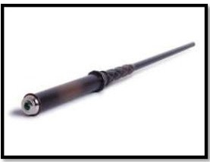
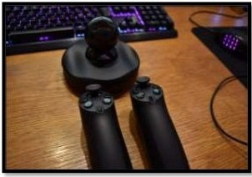
Hardware Devices
Input Devices :-
Prio VR
Magic wand
Razer Hydra

Slide 10
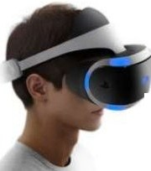
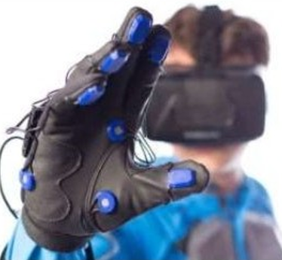
Output Devices
Headset
Sensing Gloves

Slide 11
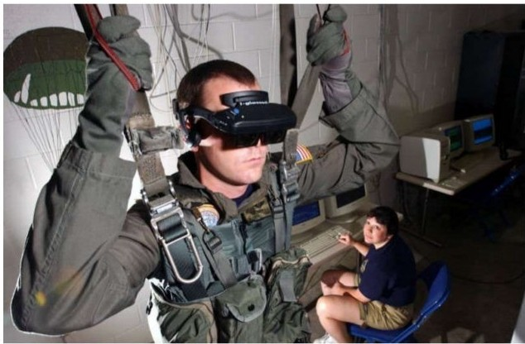
Applications of Virtual Reality
1. Virtual Reality in the Military

Slide 12
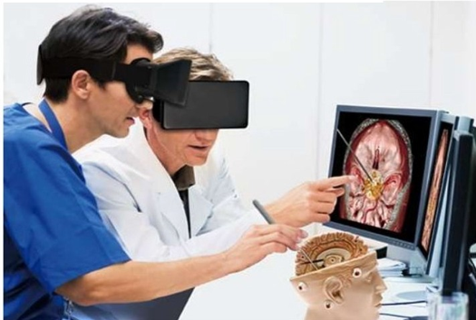
2.VR in Healthcare

Slide 13
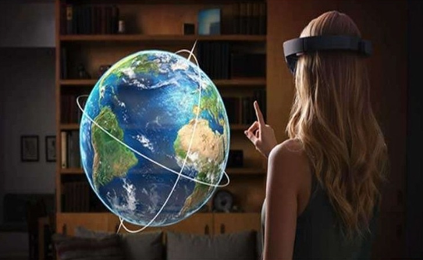
3. Virtual Reality and Education

Slide 14
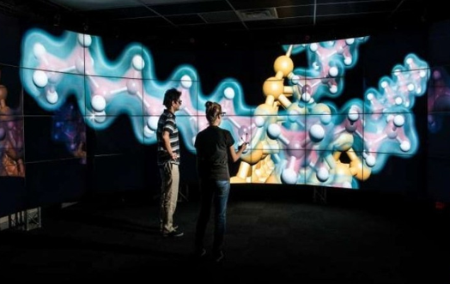
4.Virtual Reality in Scientific Visualization

Slide 15
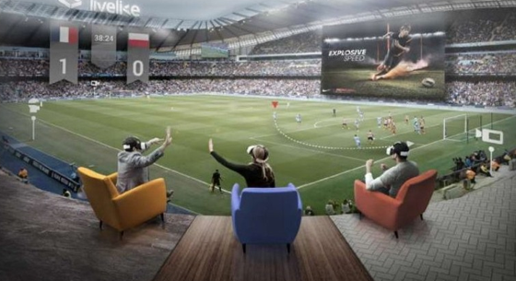
5.Virtual Reality in Entertainment

Slide 16
Advantages and Disadvantages
Advantages | Disadvantages
Virtual Reality creates a realistic world | The equipment used in VR are very expensive.
It enables user to explore places | It consists of complex technology.
Through VR user can experiment with an artificial environment. | In virtual reality environment we can’t move by our own like in the real world.

Slide 17
Resources
Virtual reality ppt (slideshare.net)
Virtual reality – Wikipedia
Virtual reality applications – Wikipedia
5 Types Of Virtual Reality – Creating A Better Future (rextheme.com)

Slide 18
Thank you

